Slide 1
逻辑 语言 意义 I Logic Language Meaning I An Introduction
Till Eumat
ultimatel1008@gmail.com
Mar, 24th 2020

Slide 2
1.1 Prerequisite
熟悉一阶逻辑句法(Syntax)、语义(Semantics)；
对之前的周会内容有一定印象；
对部分群聊内容有一定印象。
是梗集啊！

Slide 3
1.2 A Big Picture
什么是 A Big Picture?
1)背景?
2) 哲学动机?
3) 范畴变换?
梗1：哲学-反哲学？

Slide 4
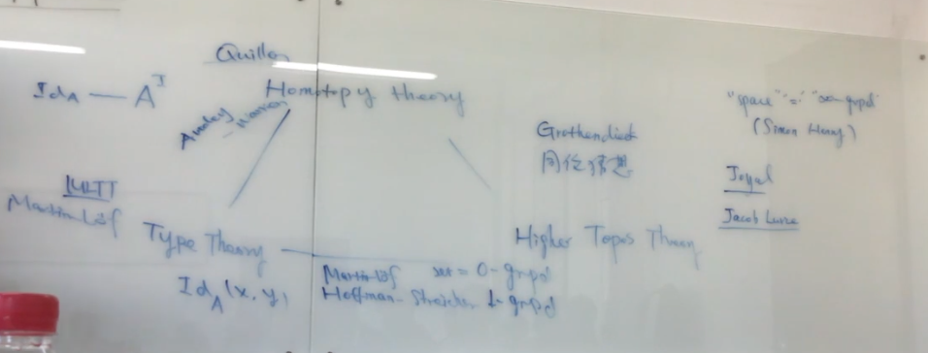
1.2 A Big Picture
例1.2.1：Homotopy Type Theory Talk

Slide 5
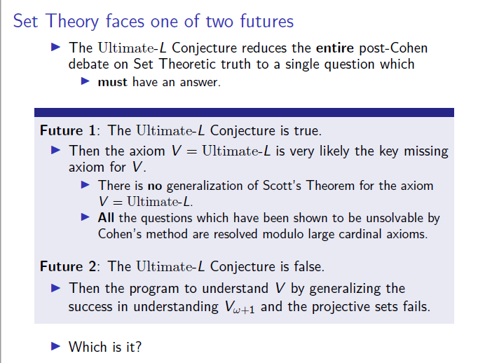
1.2 A Big Picture
例1.2.2：Woodin’s Talk on Ultimate-L

Slide 6
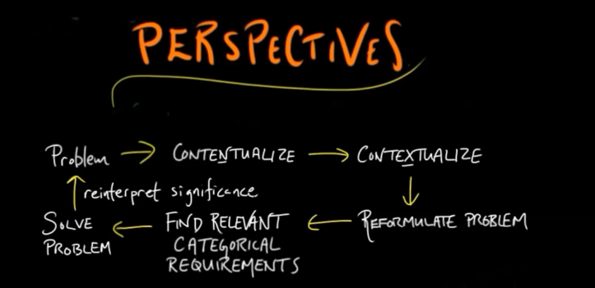
1.2 A Big Picture
例1.2.3：Categorical Transformation

Slide 7
1.2 A Big Picture
1.2.1 莱布尼茨纲领 (The Leibniz’s Program)
Universalis Characteristica（普遍文字）;
莱布尼茨做了什么？

Slide 8
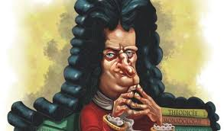
1.2 A Big Picture
例1.2.4：Leibniz,Couturat (Cf. GP 7,200)
“如果这（指普遍文字纲领）能成功的话，那么当哲学分歧产生之时，我们不再需要像以前那样听两个哲学家说着没人听得懂的鬼话，倒不如请两个数学家来。要问为何的话，那是因为届时的所谓“辩论”，不过是两人一起坐在算盘旁边，对彼此说道：扯淡，不如计算！”
例1.2.5：Leibniz,Couturat (Cf. GM 2,258)
“我发展的形而上学，正是数学。”
例1.2.6：Leibniz,Couturat (Cf. GM 4,292)
“我越发觉得真正的形而上学和逻辑学无异。”

Slide 9
1.2 A Big Picture
例1.2.6：Cf.Lenzen (1983; 1984a; 1984b; 1988)
对概念的内涵(Intensional)解释“同构”于现代的外延(extensional)解释；
“Algebra of Concepts”同构于Boole的Algebra of sets；
“Indefinite Concepts”启示了现代量词理论；

Slide 10
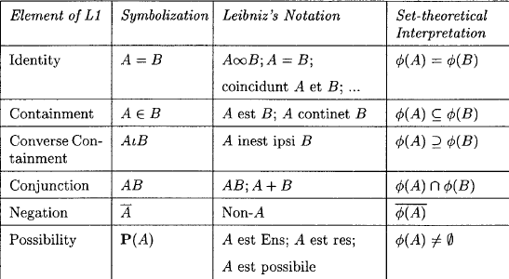
例1.2.7：Cf.Lenzen (2004)
1.2 A Big Picture

Slide 11
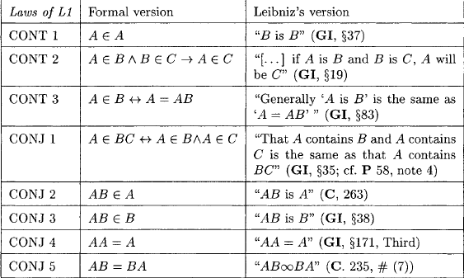
例1.2.7：Cf.Lenzen (2004)
1.2 A Big Picture

Slide 12
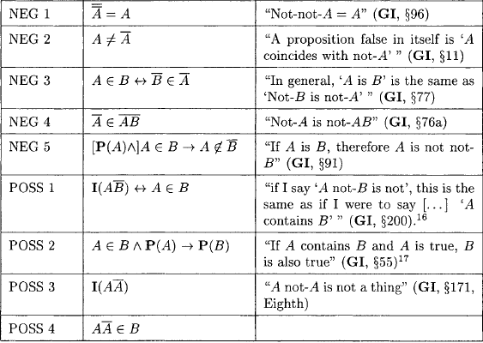
例1.2.7：Cf.Lenzen (2004)
1.2 A Big Picture

Slide 13
1.2 A Big Picture
1.2.2 弗雷格纲领 (The Fregean Program)
Begriffsschrift and Compositionality
弗雷格做了什么？

Slide 14
1.2 A Big Picture
例1.2.8：Frege(1879) Begriffsschrift
A formula language
modeled upon that of arithmetic
for pure thought

Slide 15
1.2 A Big Picture
例1.2.9：The Fregean Program (Heim&Kratzer, 1998)
Compositionality

Slide 16
1.3 Montague and Model-theoretic Semantics
1.3.1 回顾生成语法(Generative Grammar)
1.3.2 Montague的伟大作品
1.3.3 Truth-conditions, Models
1.3.4 Compositionality Again

Slide 17
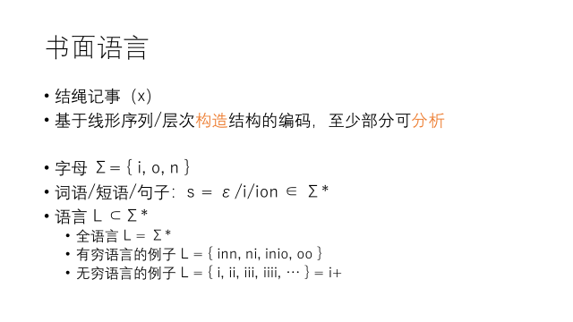
1.3.1 回顾生成语法(Generative Grammar)
语言
句子

Slide 18
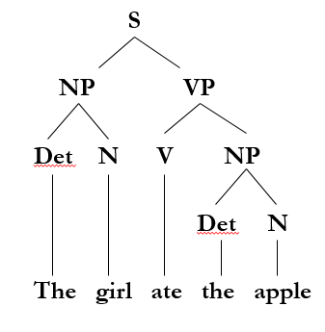
1.3.1 回顾生成语法(Generative Grammar)
The girl ate the apple.
Def 1.3.1 文法（Grammar）
G=(S, V, P, T), 其中S，V， P，T为集合。
S ----- Start Symbol(开始符号)；
V ----- Variable (变量)，非终极符，语法范畴；
P ----- Production (产生式，语法规则)，具有α→β的形式；
T ----- Terminal(终极符)，语言的句子中出现的字符；

Slide 19
1.3.1 回顾生成语法(Generative Grammar)
Word-level | Phrasal
N=noun A=adjective V=verb P=preposition Det=determiner Adv=adverb Conj=conjunction | NP=noun phrase AP=adjective phrase VP=verb phrase PP=preposition phrase S=sentence or clause

Slide 20
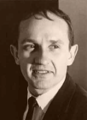
1.3.2 Montague and Montague’s works
Student of Tarski
A Central Idea: Formal Philosophy ←太艰难
The Secondary Idea: English as a Formal Language (1970)
---NCPE (1960)
---EFL (1970a)
---UG (1970b)
---PTQ (1973b)

Slide 21
1.3.3 Truth Conditions, Models
例1.3.1：There is a circle in the square.
Situation (a)
Situation (b)

Slide 22
1.3.3 Truth Conditions, Models
对Truth Conditions的描述：
“There is a circle in the square”
is true in any situation where there is a circle in the square;
is false in any situation where there isn’t a circle in the square.
简化：“There is a circle in the square”iff there is a circle in the square.
“φ” is true iff φ. T-sentence (Tarski, 1935)

Slide 23
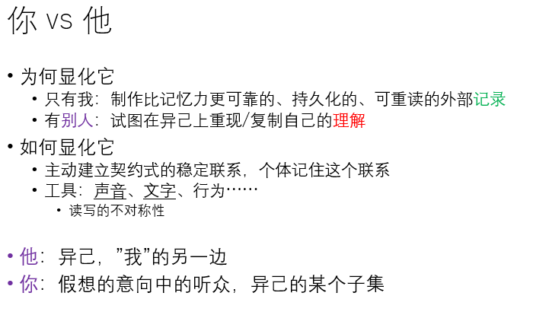
1.3.3 Truth Conditions, Models

Slide 24
1.3.3 Truth Conditions, Models
提示：对象语言（Object language） V.S. 元语言（Meta-Language）
“φ” is true iff φ.
φ是对象语言；
Φ是元语言。
Remarks:
对象语言和元语言不一定要相同。
例1.3.2：
“Snow is white”iff 雪是白的。

Slide 25
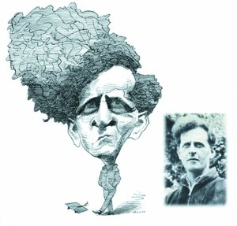
1.3.3 Truth Conditions, Models
Meaning 是什么？一个句子的meaning如何理解？
“To know the meaning of a sentence is to know its truth-conditions.” (Heim & Kratzer, 1998)
“Semantics with no treatment of truth conditions is not semantics.” (Lewis, 1970)
“To know the meaning of a sentence is to know what is the case if it is true.” (Tractatus, 4.024)
???

Slide 26

1.3.3 Truth Conditions, Models
例1.3.1：There is a circle in the square.
令φ =“There is a circle in the square.”
φ在Situation(a)中为真。
Situation(a)就是φ的一个模型，记为Ma
我们知道φ在Situation(a)中为真，记作:
${[φ]}^{Ma}$=1
Situation (a)

Slide 27

1.3.3 Truth Conditions, Models
例1.3.3：
a) There are 3 black circles;
b) There is a white triangle;

Slide 28
1.3.1 Compositionality Again
M
例1.3.4：
M
M
S
NP VP
N V
Mike Laughs
S S
NP VP
N V
Mike Laughs
M
=
Mike Laughs.
=

Slide 29
The Creed of Realism:
The Truth will set you free (John 8:32).
The Truth will not set you free if you are not free to hear it.
Wir mussen wissen. Wir werden wissen (Hilbert, 1930).
……

